Slide 1
GluonCV: Segmentation
Hang Zhang
Applied Scientist, Amazon Web Services.
01/29/2019

Slide 2
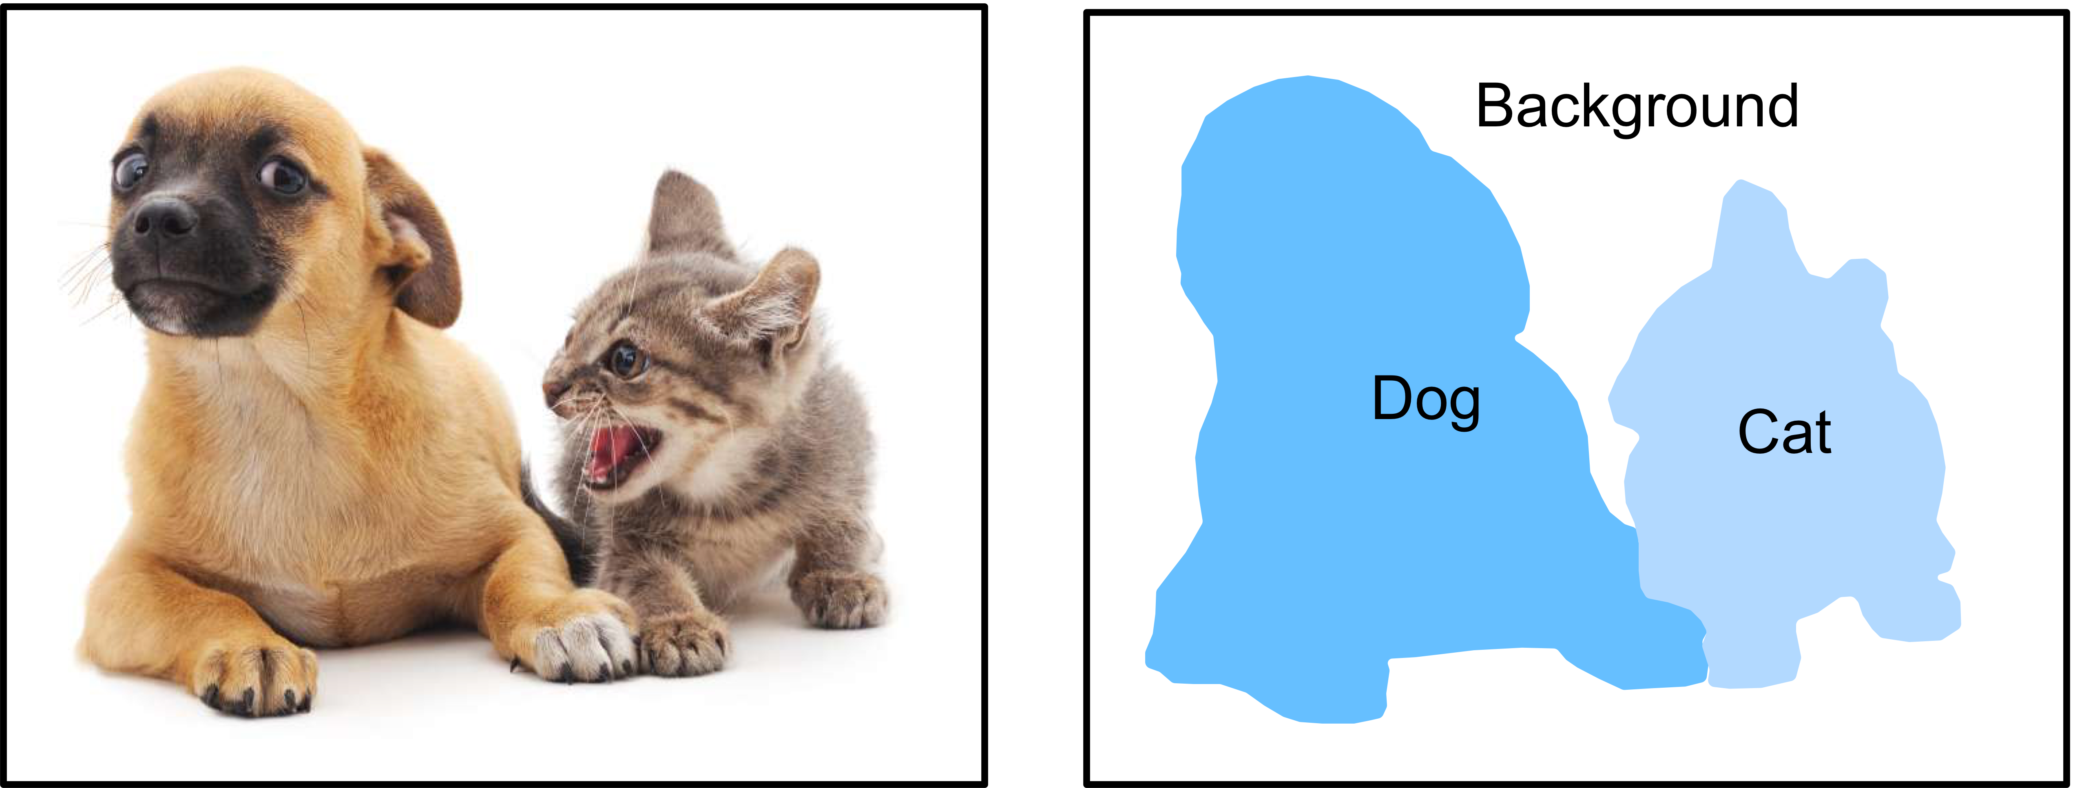
What is segmentation?
Classify and mask the pixels of the object

Slide 3
Why Segmentation?
Precise information

Slide 4
Segmentation
Semantic Segmentation Instance Segmentation

Slide 5
Segmentation with Deep Learning
Comparison
Classification:
Input: image
Output: class label
Evaluation: accuracy
Detection:
Input: image
Output: boxes with labels
Evaluation: IoU
Segmentation:
Input: image
Output: mask with label
Evaluation: mIoU, pixAcc

Slide 6
Segmentation with Deep Learning
Mask

Slide 7
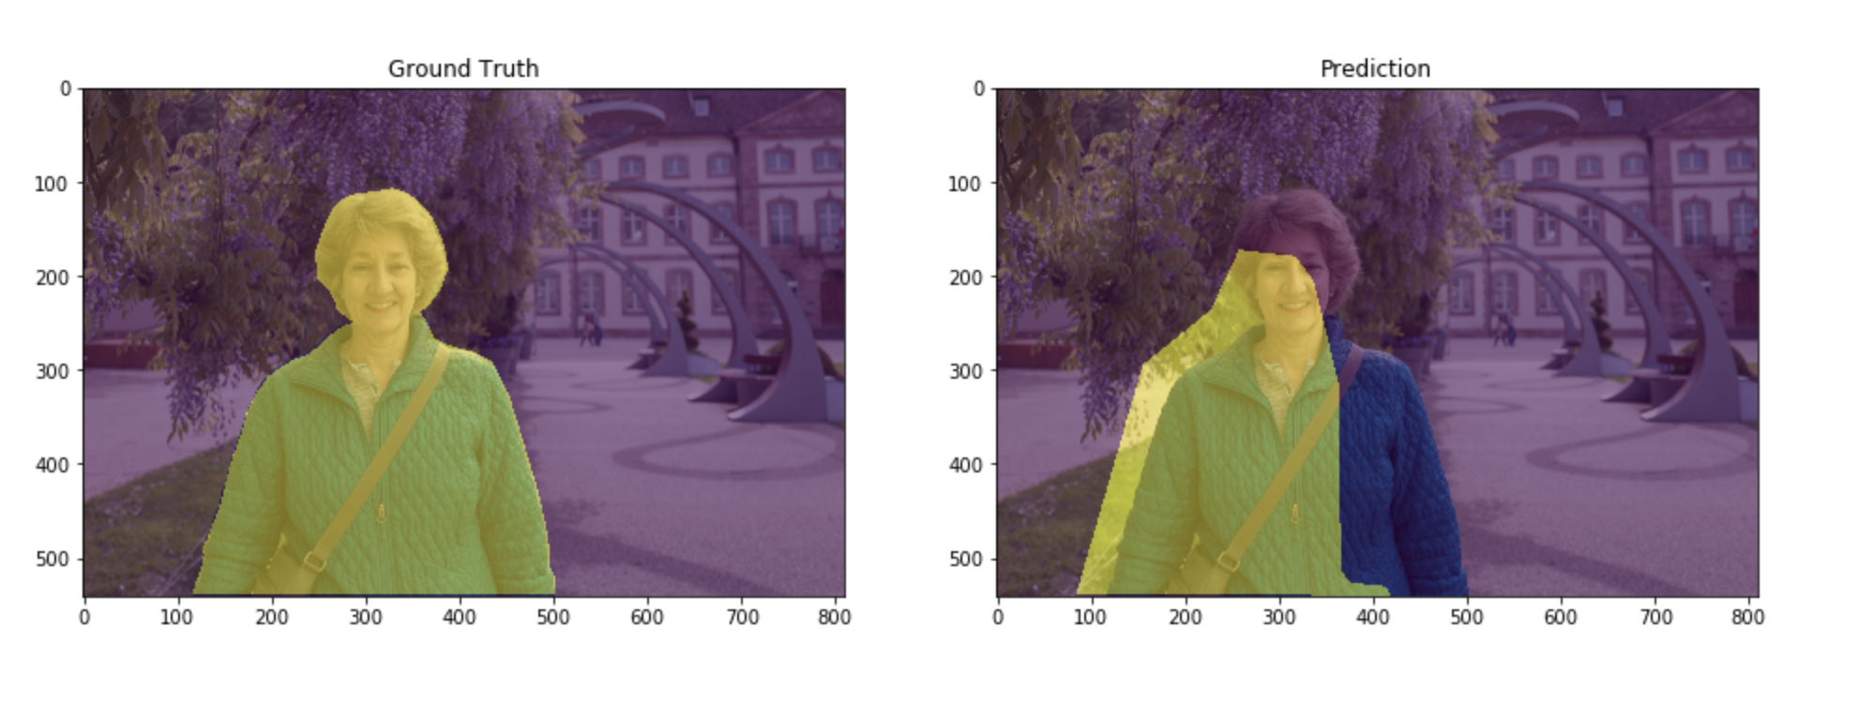
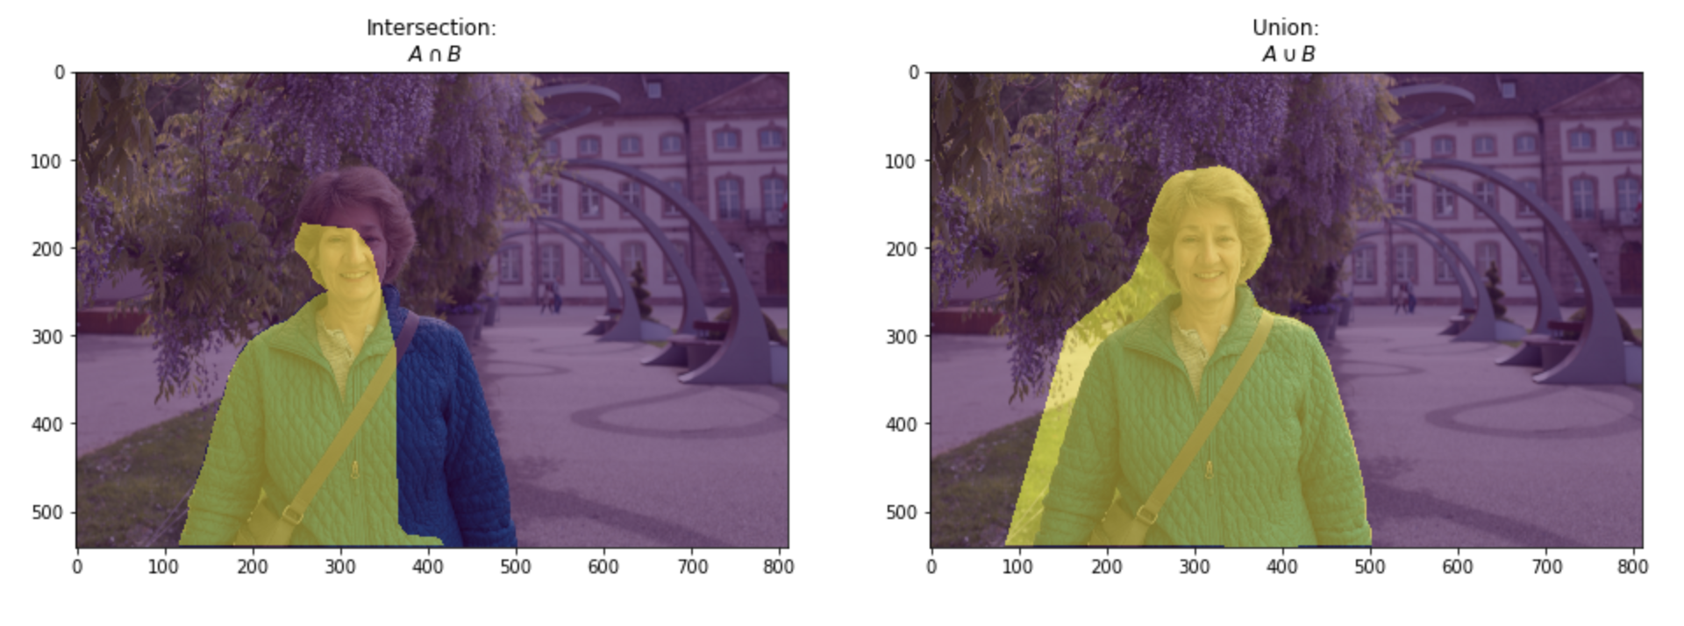
Segmentation with Deep Learning
IoU
Similar to Detection

Slide 8
Segmentation with Deep Learning
Popular models
Semantic Segmentation
FCN
PSPNet
DeepLab v3
Instance Segmentation
Mask R-CNN

Slide 9
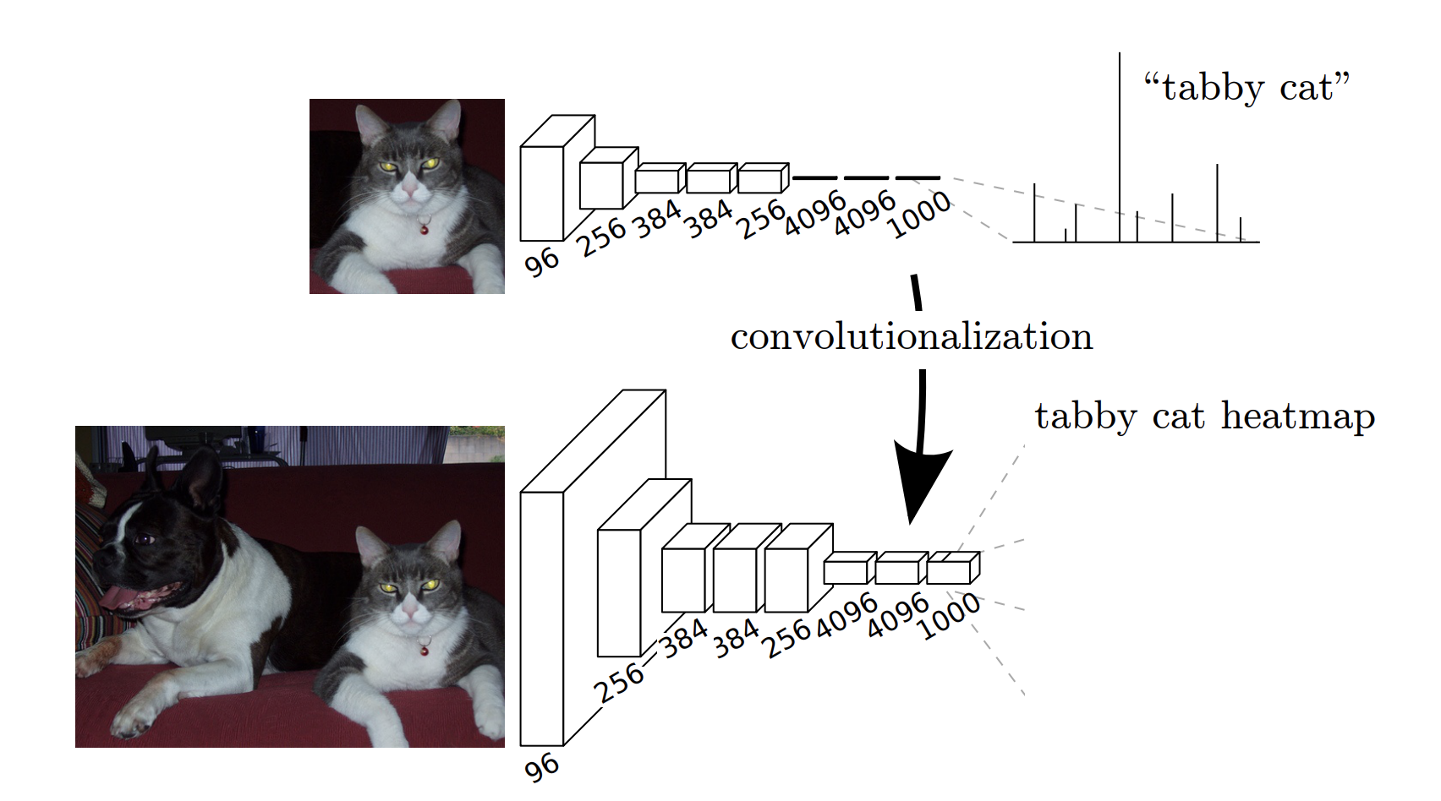
Segmentation with Deep Learning
FCN: Fully Convolutional Network

Slide 10
Segmentation with Deep Learning
FCN: Fully Convolutional Network

Slide 11

Segmentation with Deep Learning
Upsampling
Small to large feature map

Slide 12
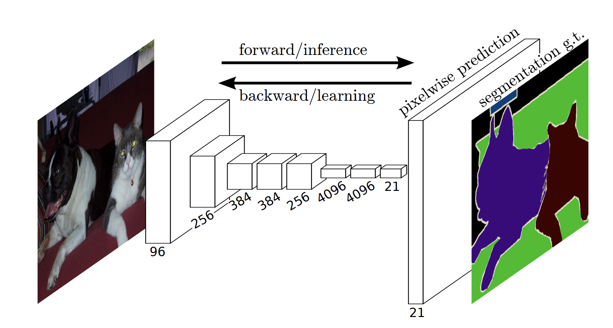
Segmentation with Deep Learning
FCN: Fully Convolutional Network

Slide 13


Segmentation with Deep Learning
Dilated Convolution
Normal
Dilated

Slide 14
Segmentation with Deep Learning
Dilated Convolution
Preserve information
Keep feature map size
Larger reception field

Slide 15
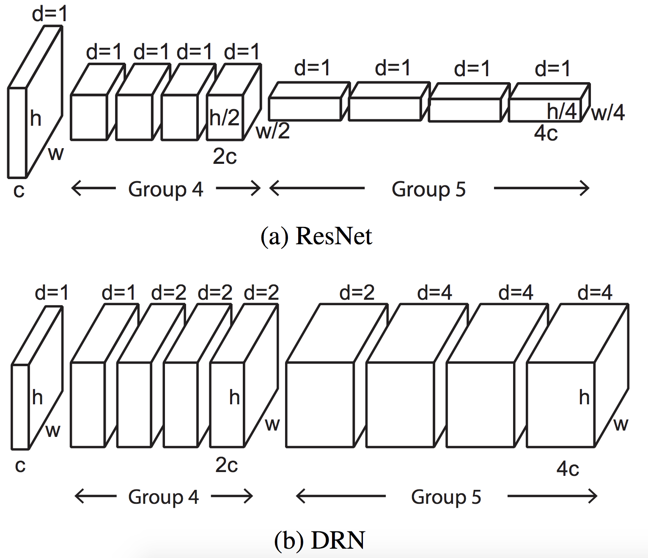
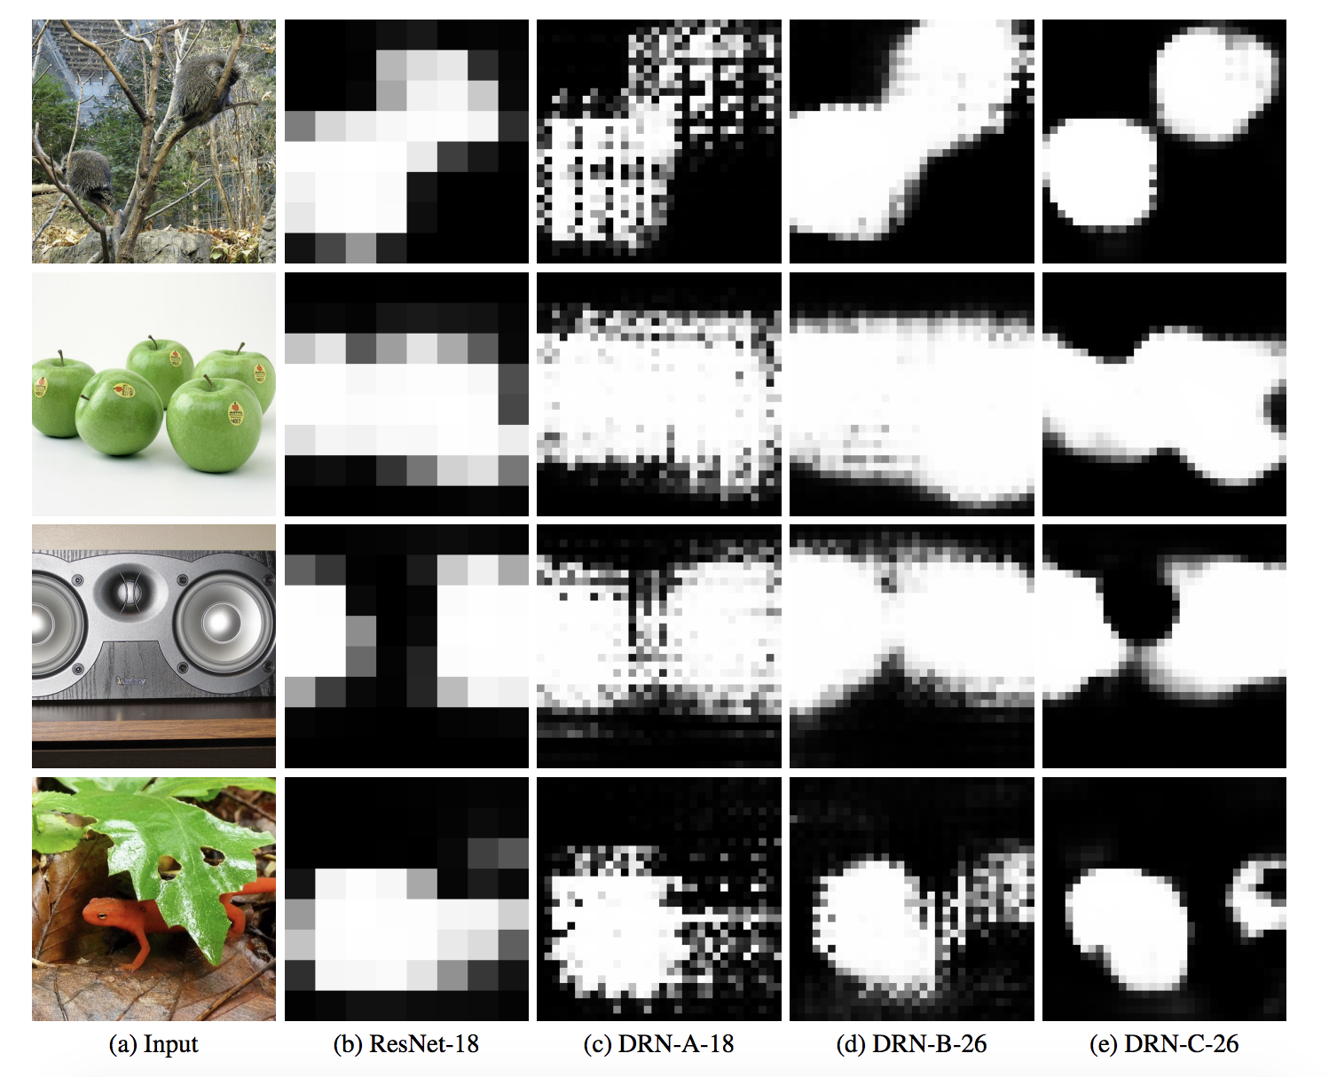
Segmentation with Deep Learning
Dilated Residual Network

Slide 16
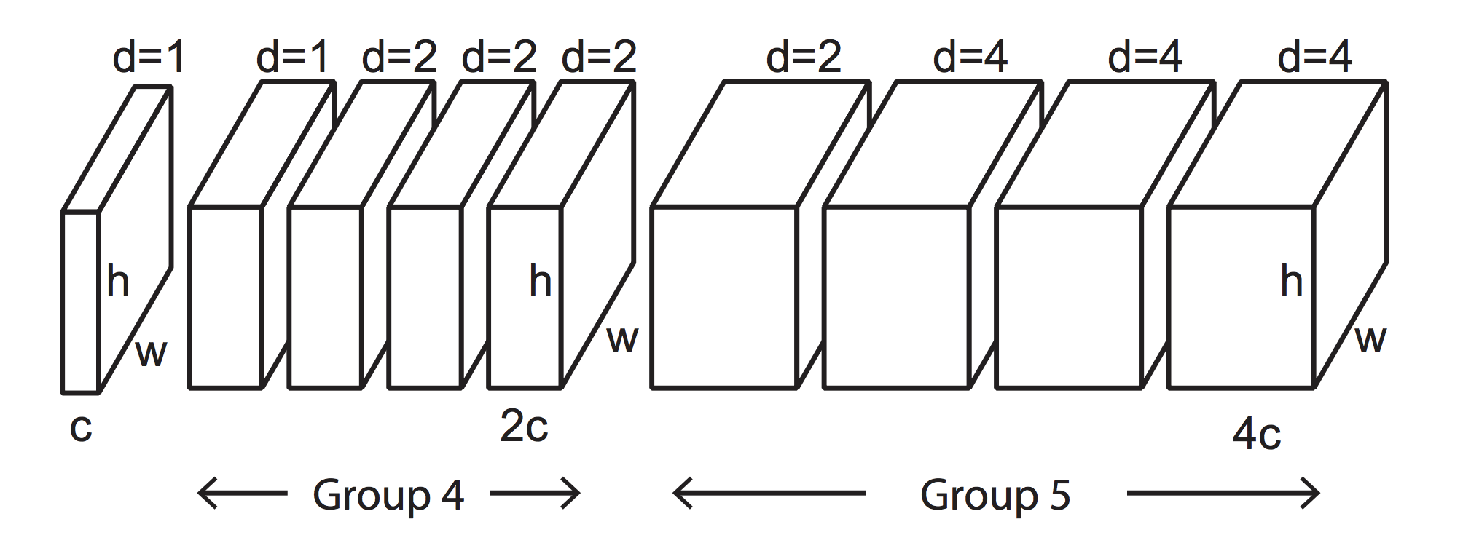
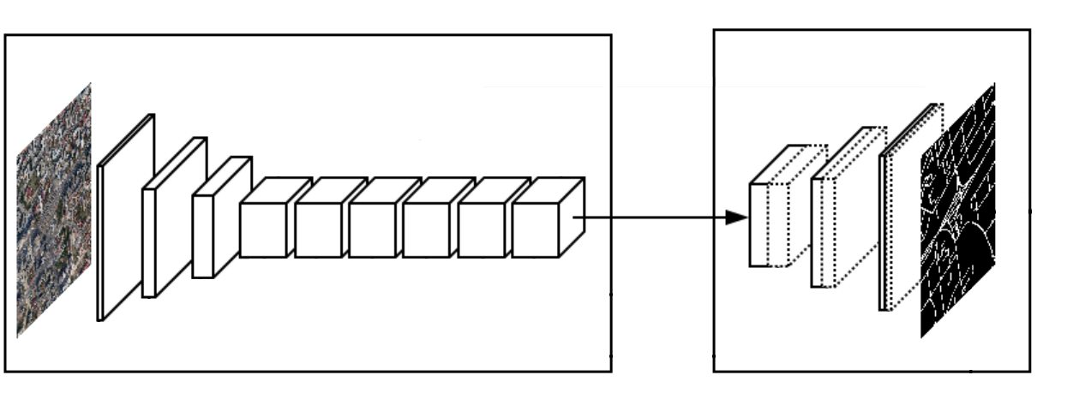
Segmentation with Deep Learning
FCN + Dilation

Slide 17
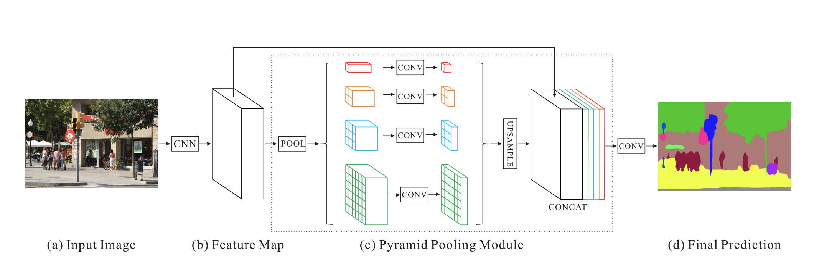
Segmentation with Deep Learning
PSP: Pyramid Scene Parsing Network

Slide 18
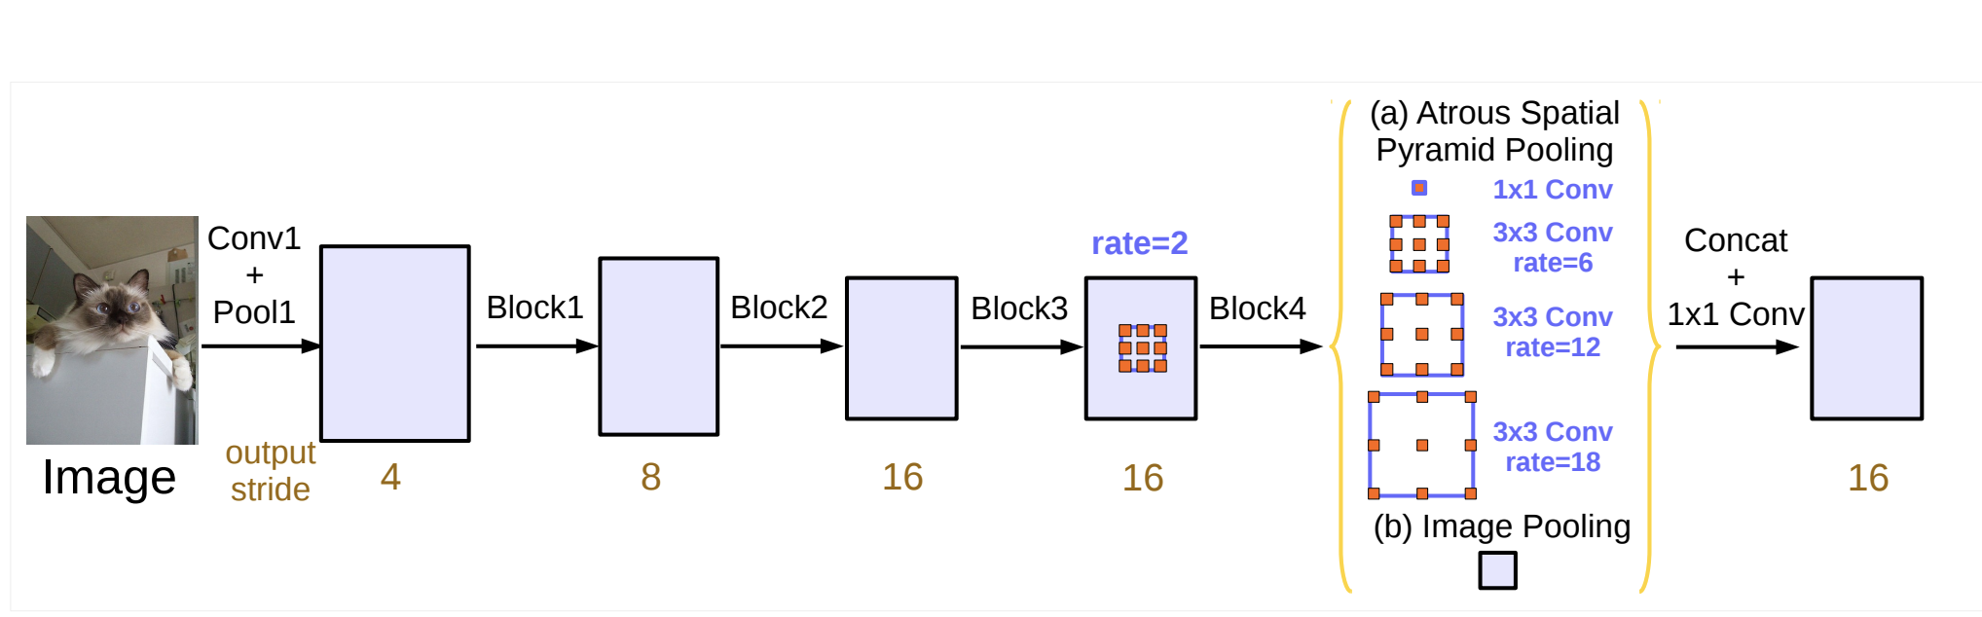
Segmentation with Deep Learning
DeepLab V3

Slide 19
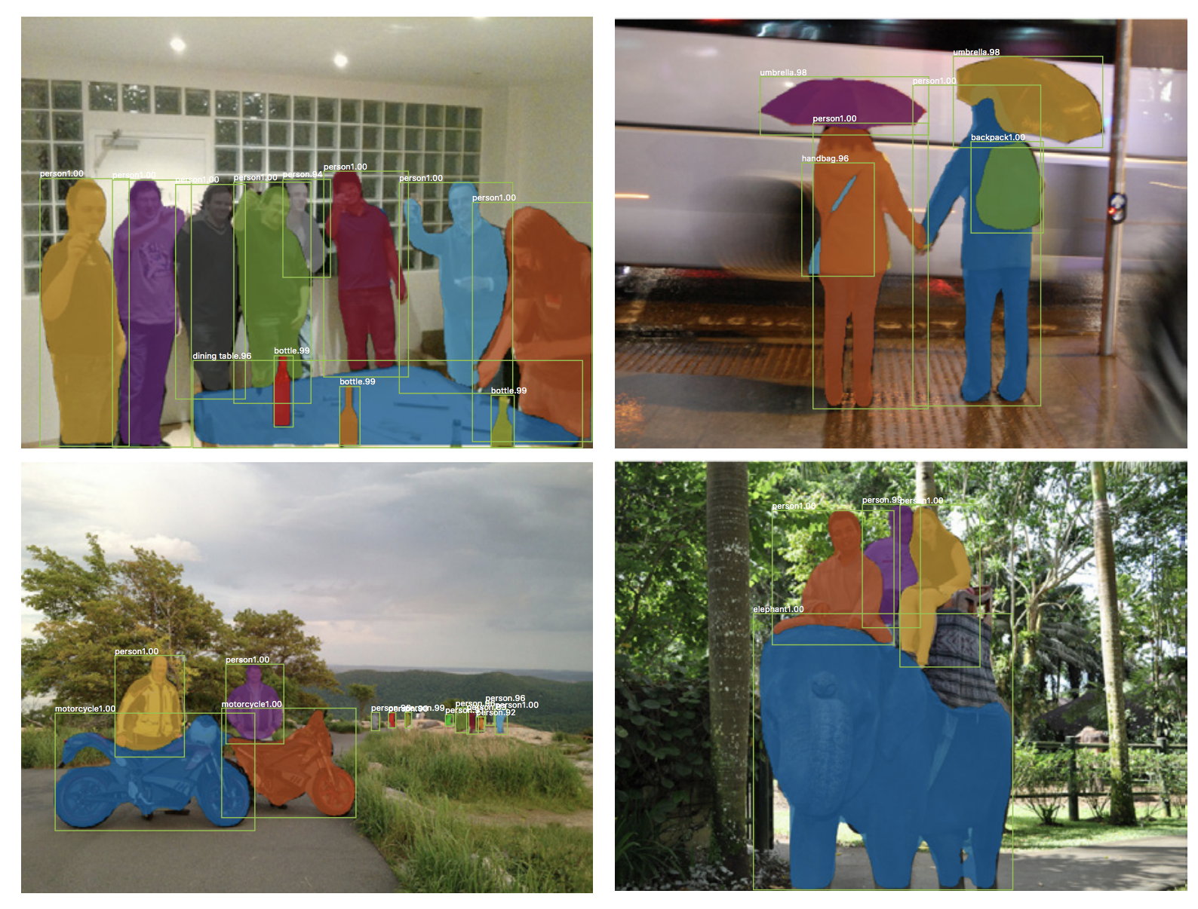
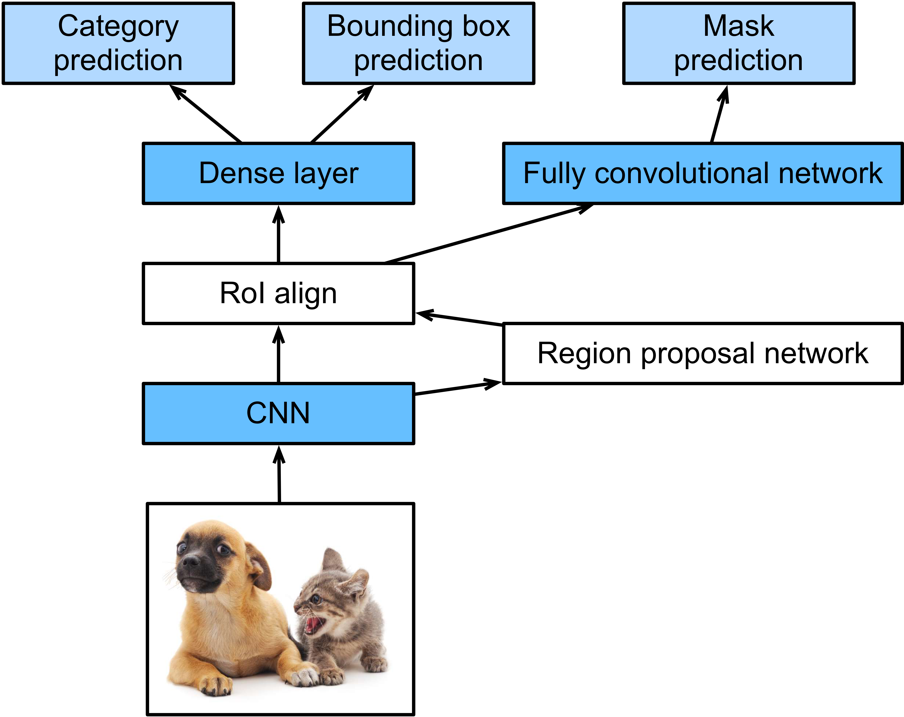
Segmentation with Deep Learning
Mask R-CNN

Slide 20
Segmentation with Deep Learning
Summary
FCN
easy to implement, less accurate
PSPNet
Slower, more accurate
DeepLab
Even slower, very accurate

Slide 21
Segmentation with GluonCV

Slide 22
Segmentation with GluonCV
Our Office in Palo Alto, California

Slide 23
Segmentation with GluonCV
Model Zoo
DeepLab-v3 | mIoU on VOC | 86.7% | 85.7% (paper)
Mask-RCNN | mask AP on COCO | 33.1% | 32.8% (Detectron)

Slide 24
Segmentation with GluonCV
Advanced Training
Learning Rate Schedule
Multi-Transfer Learning
MS COCO -> Pascal VOC Augmented -> Pascal VOC

Slide 25
Segmentation with GluonCV
Multi-Transfer Learning
DeepLab V3
MS COCO -> Pascal VOC Augmented -> Pascal VOC

Slide 26
Segmentation with GluonCV
Resources:
Model Zoo: https://gluon-cv.mxnet.io/model_zoo/segmentation.html
Tutorials: https://gluon-cv.mxnet.io/build/examples_segmentation/index.html
Deep Learning Book: http://en.diveintodeeplearning.org/

Slide 27
Semantic Segmentation
Image and Ground Truth

Slide 28
Metrics in Semantic Segmentation
PixAcc
mIoU
IoU for each category across the dataset
Mean of the IoUs over the categories
Metric API

Slide 29
Available Segmentation Models in GluonCV
Semantic Segmentation
FCN
PSPNet
DeepLab v3

Slide 30
FCN: Fully Convolutional Network
Long, Jonathan, Evan Shelhamer, and Trevor Darrell. "Fully convolutional networks for semantic segmentation." Proceedings of the IEEE conference on computer vision and pattern recognition. 2015.
Notes:
Meta algorithm for seg, which every SOTA algorithm builds on it. Only conv layer, translation equivariant.
Alexnet. FC=> 1x1 convolution , feed larger input image => a prediction map, corresponding to the
ResNet, easier, rm the global pooling layer and change the

Slide 31
Visualize FCN Activations
Zhou, Bolei, et al. "Learning deep features for discriminative localization." Proceedings of the IEEE Conference on Computer Vision and Pattern Recognition. 2016.
Notes:
Motivation/visualize why it works
FCN => sliding widnow, preserves the spatial location
The FC layer, which is a linear operation, which is interchangeable with the previous global pooling layer.
The FC before the softmax layer, acts as a linear classifier.

Slide 32

Fractionally-Strided Convolution
Small to large feature map
Notes:
Featuremap is downsampled

Slide 33
Segmentation with Deep Learning
FCN: Fully Convolutional Network
Notes:
Decoder is used in FCN, but modern algorithm typically use dilated conv instead

Slide 34

Segmentation with Deep Learning
Dilated/Atrous Convolution
Normal
Dilated
Notes:
1. What is dilated/atrous convolution?
As you may be very familiar with, it adds zeros in between of the original weights
2. What is the effect of dialted convolution and how it is used in the pre-trained base network for semantic segmentation?

Slide 35
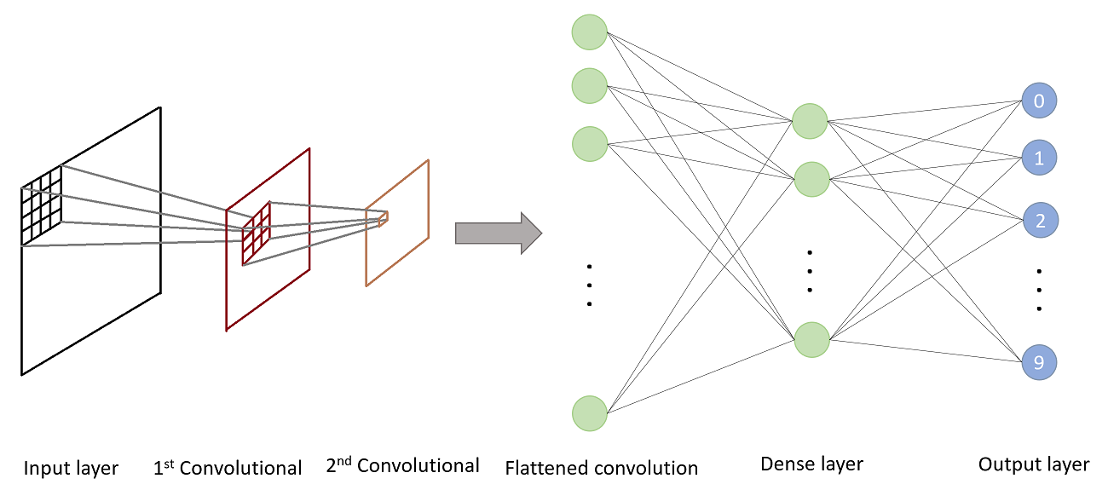
Dilated/Atrous Convolution
Dilated ResNet (API available)
Notes:
2. What is the effect of dialted convolution and how it is used for semantic segmentation? Postpone the stride operation.
Think about the stride as a individual operation.
Two consequent convolutions, while the first convolution layer has a stride of 2, which can be considered as two stride-1 convolutional layers with a stride operation in the middle
If we wanted to avoid the downsampling introduced by stride operation. We can first swap the stride operation with the 2nd conv layer. Therefore, we get 2 times larger intermediate featuremap. We need to increase the dilation rate by two for the following layers.
3. How does dilated network strategy works?
moving the stride operations to all the way back to the end of the network and then removed
How to dilate ResNet? Strdide 2=> 1, increase the dilation rate by two for the layers after that strided convolution. 1st block in each stage.
Keep feature map size
Preserve semantic information
Larger reception field
API available

Slide 36
Network Dilation Strategy
Preserve information
Keep feature map size
Larger reception field

Slide 37
Segmentation with Deep Learning
FCN + Dilation
Notes:
Increase computation complexity and GPU memory usage, due to the enlarged featuremap size. Quadratically with respect to the dilation rate
=> BN

Slide 38
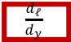
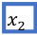
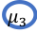
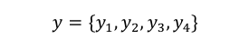
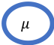
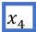
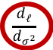
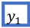
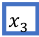
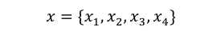
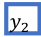
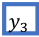
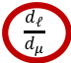
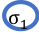
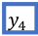
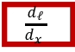
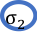
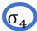

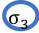
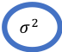
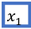
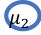

Standard BN and Data Parallelism
$$y=\{y_{1},y_{2},y_{3},y_{4}\}$$
forward
backward
GPU1
GPU2
GPU3
GPU4
y
$$\frac{d_{ℓ}}{d_{y}}$$
$$y_{1}$$
$$y_{2}$$
$$y_{3}$$
$$y_{4}$$
$$μ_{1}$$
$$σ_{1}$$
$$μ_{2}$$
$$σ_{2}$$
$$μ_{3}$$
$$σ_{3}$$
$$μ_{4}$$
$$σ_{4}$$
$$μ$$
$$σ^{2}$$
$$\frac{d_{ℓ}}{d_{μ}}$$
$$\frac{d_{ℓ}}{d_{σ^{2}}}$$
$$x_{1}$$
$$x_{2}$$
$$x_{3}$$
$$x_{4}$$
x
$$\frac{d_{ℓ}}{d_{x} }$$
$$x=\{x_{1},x_{2},x_{3},x_{4}\}$$
Standard BN with data parallel implementation.
Batch Normalization ^{[5]} in training mode.
⁵Ioffe and Szegedy. "Batch normalization: Accelerating deep network training by reducing internal covariate shift.” ICML. 2015.
Notes:
In the forward pass, Batch Normalization normalize the data within a mini-batch to have zero-mean and unit-variance, then scale and shift the data.

Slide 39
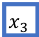
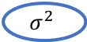
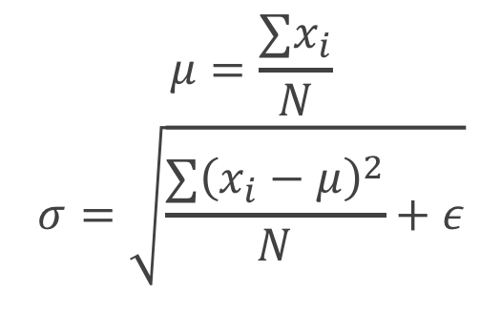
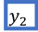

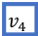
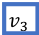
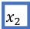
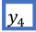
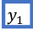
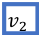
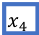
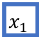
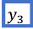
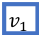
Cross-GPU Batch Norm (“Sync twice”)
$$μ=\frac{∑x_{i}}{N}$$
$$σ=\sqrt{\frac{∑{\left(x_{i}−μ\right)}^{2}}{N}+ε}$$
GPU1
GPU2
GPU3
GPU4
$$y_{1}$$
$$y_{2}$$
$$y_{3}$$
$$y_{4}$$
$$σ^{2}$$
$$v_{1}$$
$$v_{2}$$
$$v_{3}$$
$$v_{4}$$
$$μ$$
$$x_{1}$$
$$x_{2}$$
$$x_{3}$$
$$x_{4}$$
“Sync twice” Implementation^{[6,7]}
⁶Peng, Chao, et al. "MegDet: A Large Mini-Batch Object Detector.” CVPR2018
⁷Liu, Shu, et al. "Path Aggregation Network for Instance Segmentation.” CVPR2018
Notes:
Concurrent work also implemented Synchronized Batch Norm, by first calculating the global mean and then the variance, which requires synchronizing twice in each iteration.

Slide 40













Cross-GPU Batch Norm (“Sync once”)
$$μ=\frac{∑x_{i}}{N}$$
$$σ=\sqrt{\frac{∑{\left(x_{i}−μ\right)}^{2}}{N}+ε}$$
$=\sqrt{\frac{∑x_{i}^{2}}{N}−μ^{2}+ε}$ $=\sqrt{\frac{∑x_{i}^{2}}{N}−\frac{{\left(∑x_{i}\right)}^{2}}{N^{2}}+ε}$
$$y=\{y_{1},y_{2},y_{3},y_{4}\}$$
GPU1
GPU2
GPU3
GPU4
$$y_{1}$$
$$y_{2}$$
$$y_{3}$$
$$y_{4}$$
$$∑x_{i}$$
$$∑x_{i}^{2}$$
$$x_{1}$$
$$x_{2}$$
$$x_{3}$$
$$x_{4}$$
$$x=\{x_{1},x_{2},x_{3},x_{4}\}$$
Our “Sync Once” implementation
⁶Zhang, Hang, et al. "Context encoding for semantic segmentation." The IEEE Conference on Computer Vision and Pattern Recognition (CVPR). 2018.
Notes:
Concurrent work also implemented Synchronized Batch Norm, by first calculating the global mean and then the variance, which requires synchronizing twice in each iteration. Instead,
For implementating synchronized BatchNorm, We first calculating the sum of the input x and sum of x^2 in each device and applying all reduce operation to get global sums. Then we can calculate the global mean and variance using the equation on the left and continue the forward pass.
Similarly, we synchronize the gradient of sum of x and sum of x^2 during the backpropagation. This implementation is simple and only synchronize one time in each iteration.
This Sync Once implementation has been included in MXNet (the only official support in deep learning toolkit), used in GluonCV.

Slide 41
PSPNet: Pyramid Scene Parsing Network
Zhao, Hengshuang, et al. "Pyramid scene parsing network." IEEE Conf. on Computer Vision and Pattern Recognition (CVPR). 2017

Slide 42
DeepLab V3
Chen, Liang-Chieh, et al. "Rethinking atrous convolution for semantic image segmentation."

Slide 43

Additional Thoughts on PSPNet vs. DeepLab V3
Notes:
Spatial invariant representation, such that it can generalize to other spatial locations when learned from a finite variations from the training data.

Slide 44



Additional Thoughts Co-occurrent Features
Zhang, Hang, et al. ”Co-occurrent Features in semantic segmentation."
Notes:
The network can learn some corelations, but cannot leverage that smartly.
1. receptive field size, input image, but lower level featuremap contains less semantic information.
2. Spatial sensitive representation
We discuss this in a recent paper will be available on arXiv after legal approval.
The method will be provided in GluonCV upon publication.

Slide 45
Segmentation with GluonCV
Featured Models and dataset
 | Dataset | Backbone | mIoU
PSPNet | Pascal VOC | ResNet101 | 85.1%
DeepLab-v3 | Pascal VOC | ResNet101 | 86.7%
PSPNet | ADE20K | ResNet101 | 42.9%
DeepLab-v3 | ADE20K | ResNet101 | 44.1%
PSPNet | Cityscapes | ResNet101 | 77.1%
Models: https://gluon-cv.mxnet.io/api/model_zoo.html#semantic-segmentation
Datasets: https://gluon-cv.mxnet.io/api/data.datasets.html
Model Zoo: https://gluon-cv.mxnet.io/model_zoo/segmentation.html
Notes:
MS COCO -> Pascal VOC Augmented -> Pascal VOC

Slide 46
Thank you!
Resources:
Model Zoo: https://gluon-cv.mxnet.io/model_zoo/segmentation.html
Tutorials: https://gluon-cv.mxnet.io/build/examples_segmentation/index.html
Deep Learning Book: http://en.diveintodeeplearning.org/

Slide 47
Segmentation with GluonCV
Hands On!

